Slide 1
MindMapper
YOUR NAME
COMPANY
PROJECTS
DD/MM/20XX
Study Smart. Remember More.

Slide 2
Introduction
Discover MindMapper, an AI-powered learning app that transforms your study materials into interactive visuals. Our goal is to help students learn efficiently, retain more, and enjoy the process.

Slide 3
Problem
01

Slide 4
Time-consuming note-making
Manual note-making consumes valuable study time, reducing productivity and increasing stress for students.

Slide 5
Low retention rates
Traditional studying often results in poor information retention, causing frustration and repeated efforts.

Slide 6

Boring and ineffective study methods
Many students find current study methods dull, lacking engagement and motivation for consistent learning.

Slide 7
Solution: MindMapper
02

Slide 8
AI-powered transformation of notes
Our app uses AI to instantly convert textbooks, PDFs, and notes into dynamic study formats.

Slide 9
Multiple interactive formats in one app
Access mind maps, flashcards, quizzes, and summaries all in one seamless platform.

Slide 10

Instant generation of mind maps, quizzes, flashcards
Upload your notes and get immediate interactive study aids designed to boost retention and engagement.

Slide 11
How It Works
03

Slide 12
Upload textbooks, PDFs, or notes
Simply upload your study materials in common formats, no formatting skills needed.

Slide 13
AI processes and converts content
Behind the scenes, advanced AI analyzes and restructures the content for better learning tools.

Slide 14
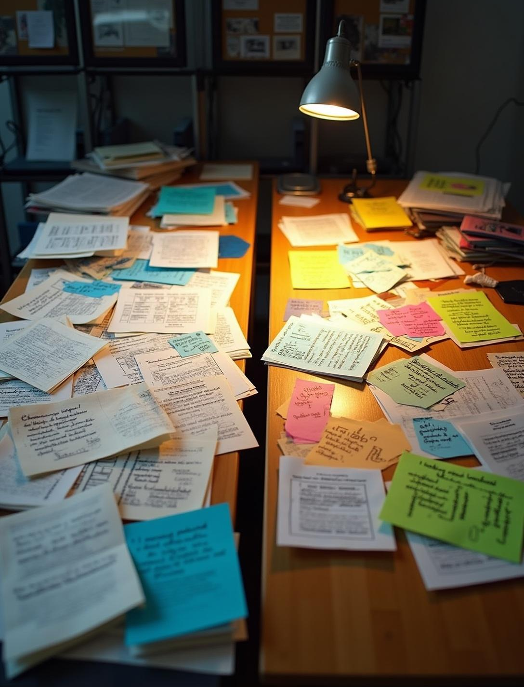
Visual before/after examples of study materials
See a clear comparison: from static text to vibrant, colorful mind maps and quizzes.

Slide 15
Features
04

Slide 16
Interactive mind maps
Create and explore colorful, easy-to-understand mind maps that illustrate key concepts.

Slide 17
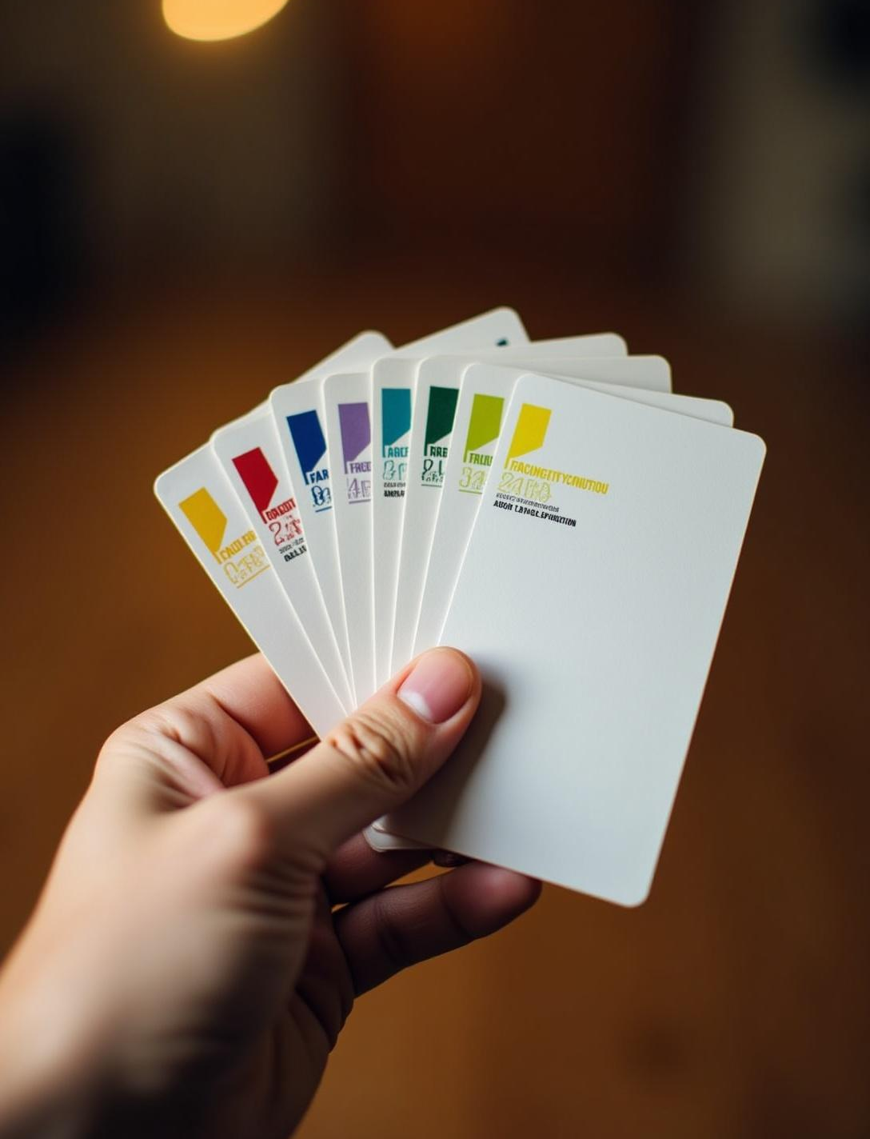
Flashcards with spaced repetition
Harness the power of spaced repetition to enhance memory and recall effectively.

Slide 18
Quizzes, summaries, and sharing options
Engage with interactive quizzes, concise summaries, and easy sharing to enrich collaborative study experiences.

Slide 19
Market Opportunity
05

Slide 20

Size and growth of global EdTech market
The global EdTech market is rapidly expanding, projected to reach over $400 billion in the near future.

Slide 21
Target segments: students, educators, institutions
MindMapper targets diverse segments including individual students, educators, and educational institutions worldwide.

Slide 22
Trends driving demand for smart learning tools
Growing digital adoption, AI integration, and demand for personalized learning boost smart tool adoption.

Slide 23
Business Model & Competitive Advantage
06

Slide 24
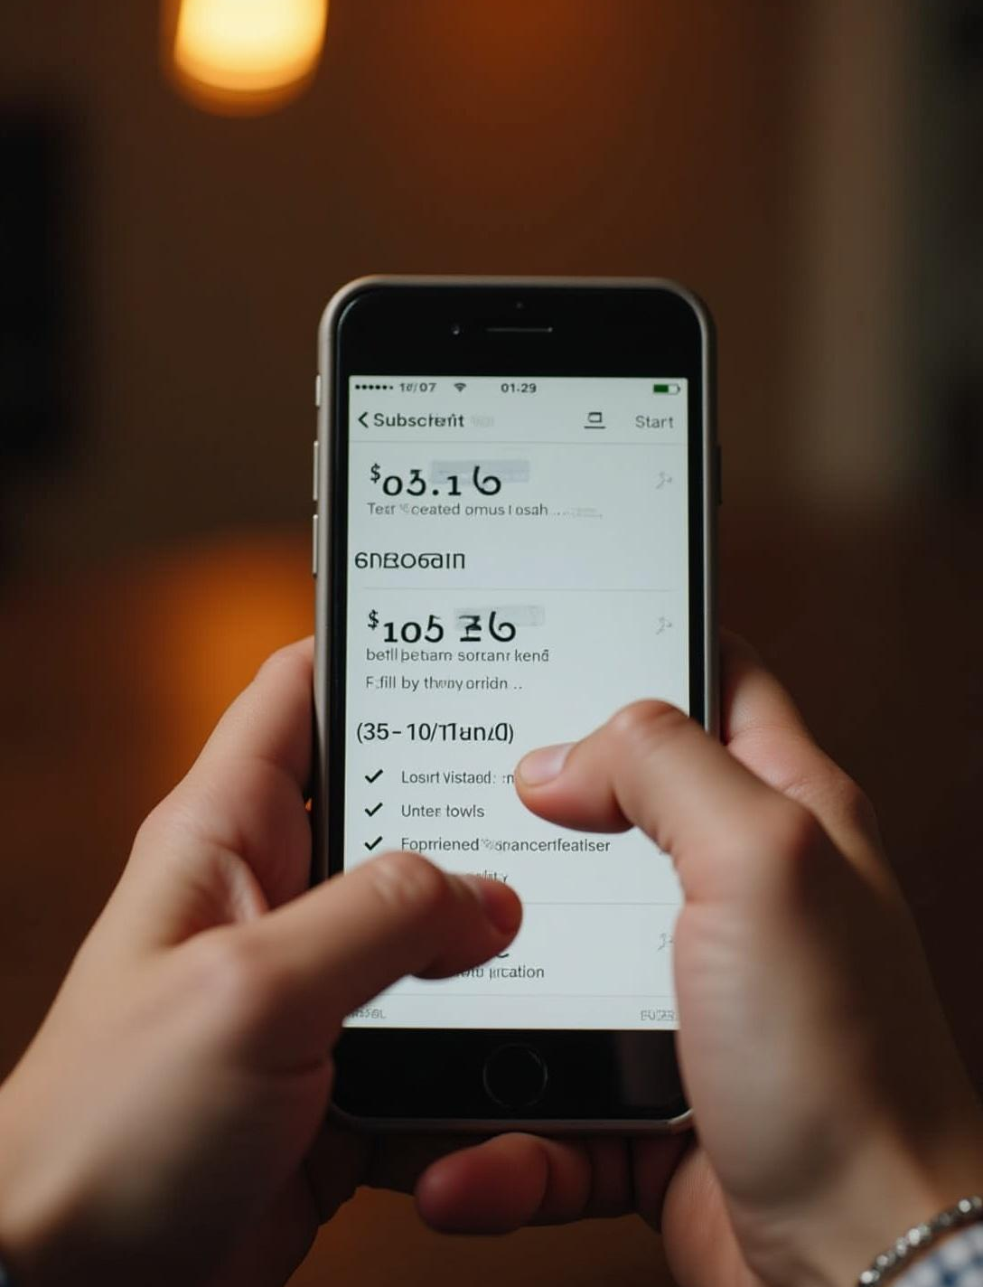
Freemium and premium subscription plans
Offers a freemium model with premium plans priced between $5–10/month to unlock advanced features.

Slide 25
B2B partnerships and marketplace strategy
Pursues collaborations with schools and organizations plus a marketplace for educational content and tools.

Slide 26
Unique all-in-one format, time-saving, gamification
Unique all-in-one platform saves time with gamified features enhancing motivation and ongoing engagement.

Slide 27
Traction & Team
07

Slide 28
Positive beta test results and testimonials
Successful beta tests demonstrate high satisfaction and improved learning outcomes among early users.

Slide 29

Strategic partnerships and collaborations
Established key partnerships with educational institutions to expand reach and improve product impact.

Slide 30
Founders and advisory board expertise
Experienced founders and advisors bring deep knowledge in AI, education, and technology sectors.

Slide 31
Vision & Call to Action
08

Slide 32
Future of learning with smart AI tools
MindMapper envisions revolutionizing education by building the future of learning with smart AI tools.

Slide 33

Invitation to join and contact information
Join us on this journey! Contact MindMapper to learn more or become a partner.

Slide 34

Conclusions
MindMapper transforms studying with AI-driven tools, making learning efficient, engaging, and accessible to all students globally.

Slide 35
THANK YOU
Please keep this slide for attribution
Do you have any questions?
youremail@freepik.com
+00 000 000 000
yourwebsite.com

